Slide 1
Welcome

Slide 3
Dr. Sushila Mondal Memorial Central Library A brief Profile Raja Narendra Lal Khan women’s College Midnapore – 721 102 West Bengal

Slide 4
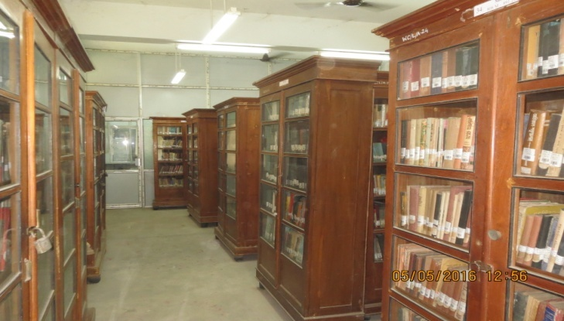
The Central Library Where history welcomes the future and heritage meets modernism

Slide 5
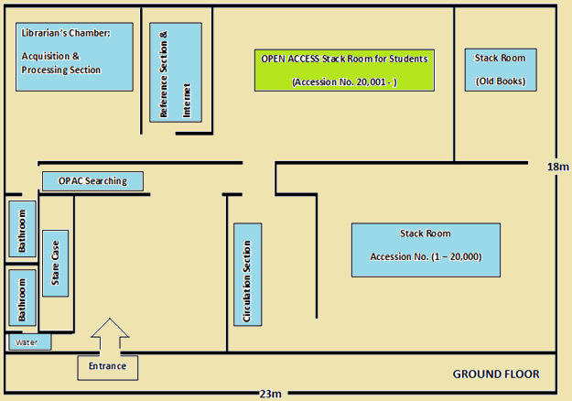
Lay Out of the Central Library (Ground Floor)

Slide 6
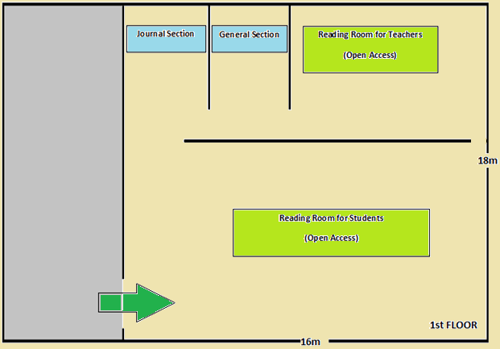
Lay Out of the Central Library (1st Floor)

Slide 7
Salient Features
Fully automated Library System through Koha.
Open Access stack-room for Students.
Large Reading Room (288 m²) with classified stacks of books and journals.
Very rich Reference Section and Periodical Section.
Steady Wi-Fi connectivity inside the Library premises.
Institutional Membership of the Central Library of Vidyasagar University.
Digital Library & Institutional Repository.
Weekly Book-talk and other extension services.
User orientation program on regular basis.
MOPAC, the Mobile Apps of the Library OPAC

Slide 8
Library Resources
Books | More than 38,000
Journal & Magazines | 35
News Papers | 4
Employment Bulletin | 2
Bound Volume of Journal | More Than 600
Online Database | N-LIST (INFLIBNET)
E-books | 100 (OUP & MGH)
E-journals | 10 (SAGE)

Slide 9
Library Services
Book Lending Service
Bibliographic Search Service (Web OPAC / MOPAC)
Reference Service
E-books & E-journal Access
Digital Library (E-Books & Institutional Repository)
Inter-Library Loan Service (Central Library, VU)
Extension Services like Book Talk etc.
User Orientation

Slide 10
Library Hour
Days | Reading Room | Circulation
Monday to Friday | 10 am to 6.30 pm | 11 am to 4 pm
Saturday | 10 am to 4 pm | 11 am to 1.30 pm
Sunday | X | X

Slide 11
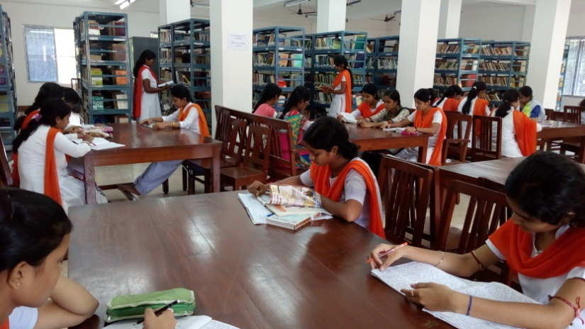
Reading Room (288 m²)

Slide 12
Reference Section
Some Prominent Titles:
The New Encyclopedia Britannica (15th ed. 1983)
McGraw-Hill Encyclopedia of Science and Technology (1960)
The Oxford English Dictionary (1933)
Encyclopedia of Religion and Ethics (1959)
The Wealth of India (1985)
The Cultural Heritage of India (1975)
Encyclopedia of The World and its People (1978)
Britannica ready reference encyclopedia (2005)
A Gazetteer of The World (1988)

Slide 13
Journal/ Magazines
Some Prominent Titles:
Anustup • Boiyer Desh • Contemporary Education Dialogue • Contemporary Voice of Dalit • Current Science • Desh • Down to Earth • Economic and Political Weekly • History and Sociology of South Asia • India Today • Indian Economic and Social History Review • Indian Historical Review • Indian Literature • Journal of Land and Rural Studies • Kurukshetra • National Geographic Magazine • Prabuddha Bharata • Samvit • Sanctuary • Science & Culture • Science Reporter • Studies in History • Studies in Indian Politics • Studies in Microeconomics • Udbodhan • Visvabani • Yojana.

Slide 14
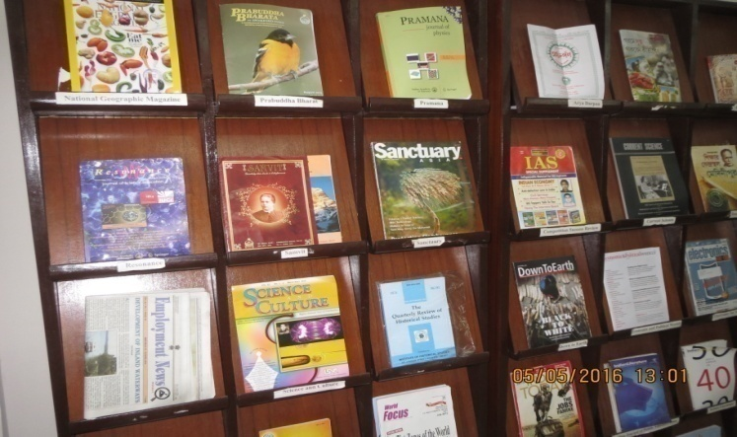
Display Stand for Journal/ Magazines

Slide 15
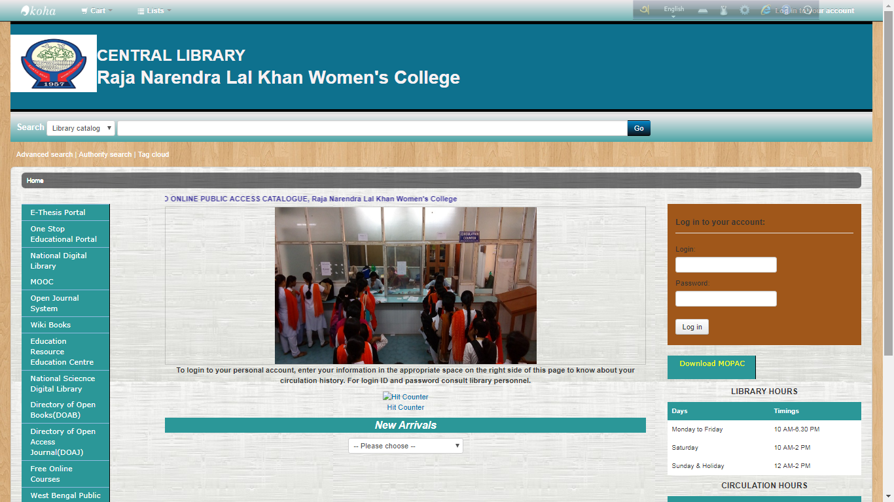
The User-friendly Web OPAC

Slide 16
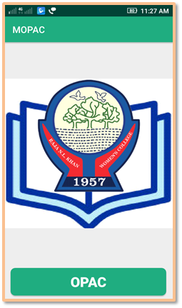
The Mobile Application of the Web OPAC

Slide 17
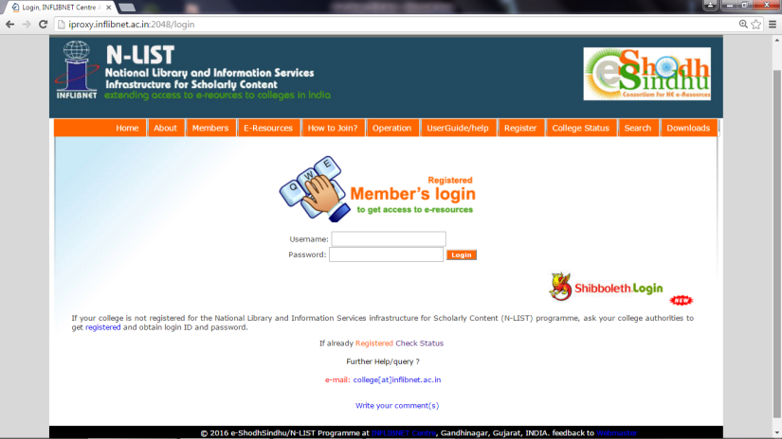
Online Database N-LIST (INFLIBNET)

Slide 18
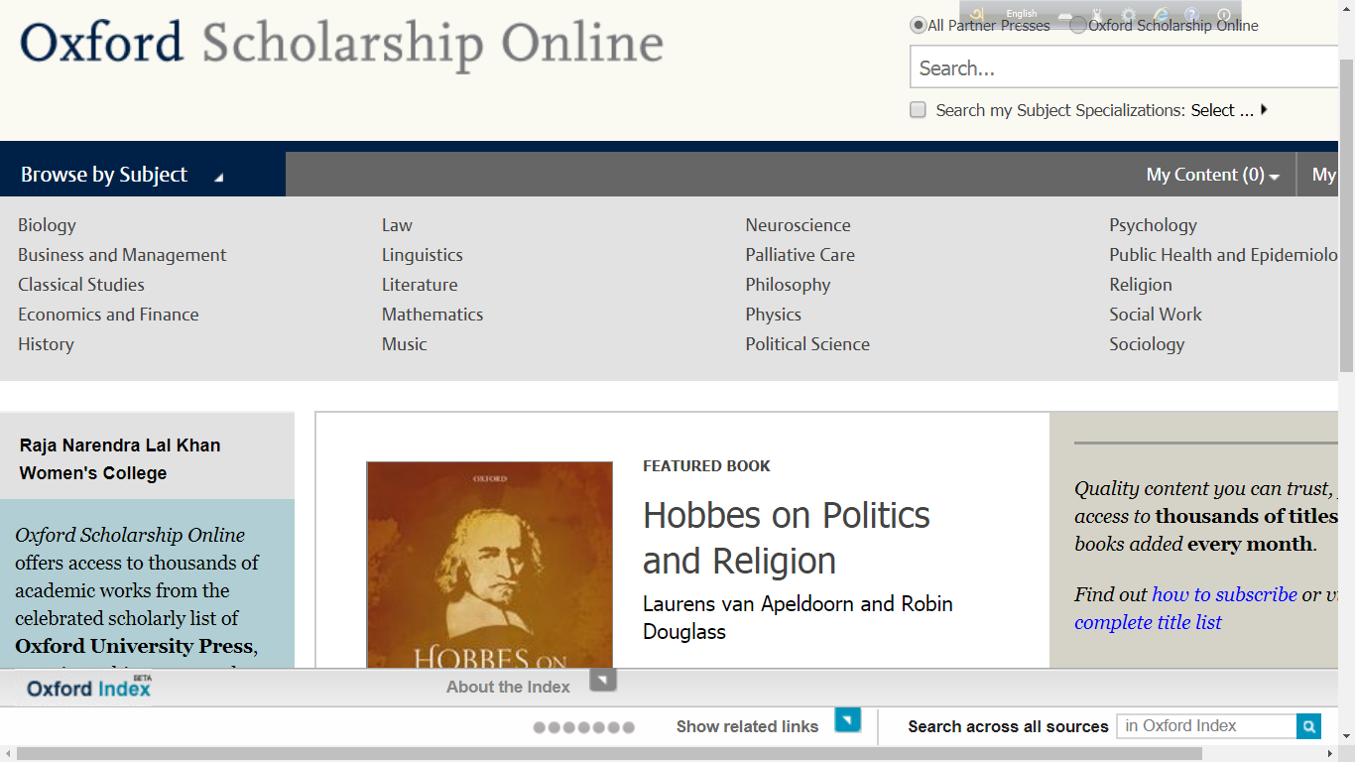
Oxford Scholarship Online

Slide 19
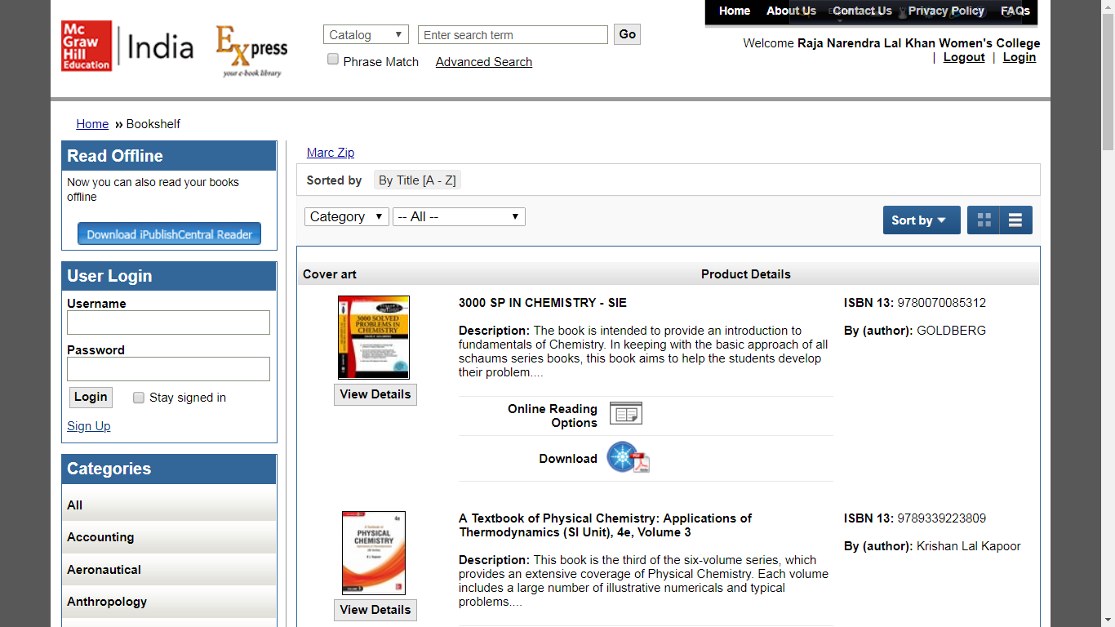
McGrawHill Education

Slide 20
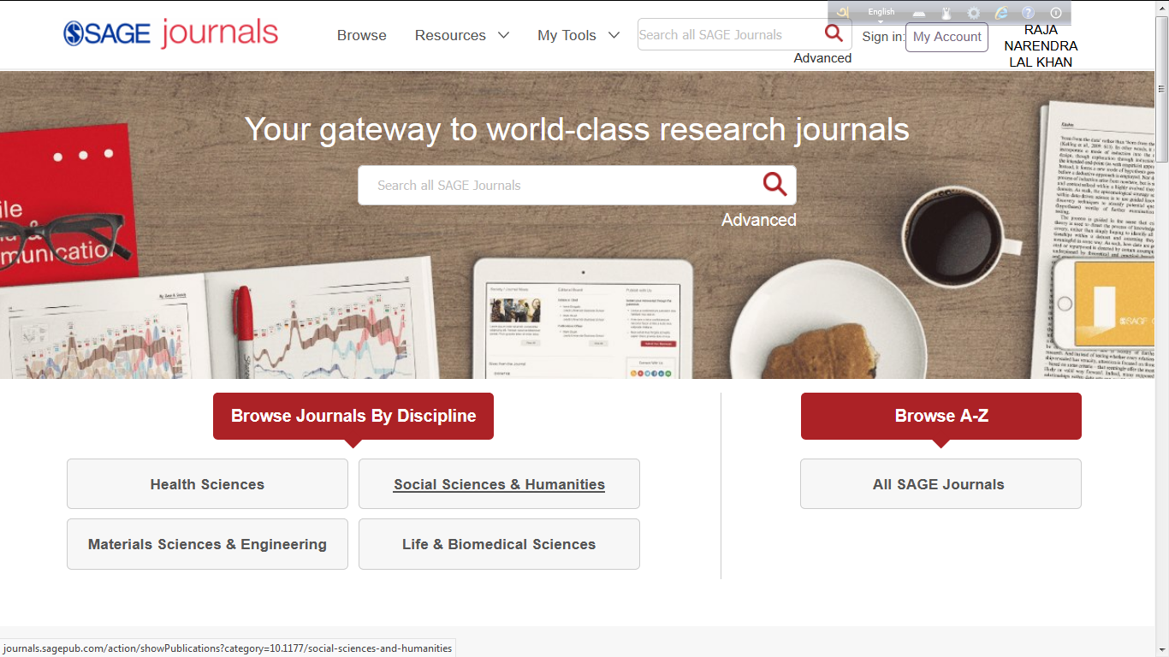
SAGE Journals

Slide 21
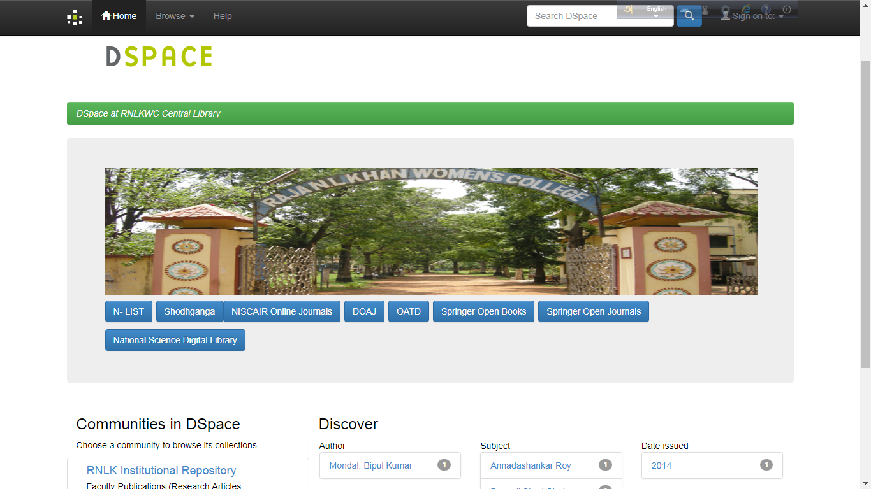
New Digital Library Interface (DSpace)

Slide 22
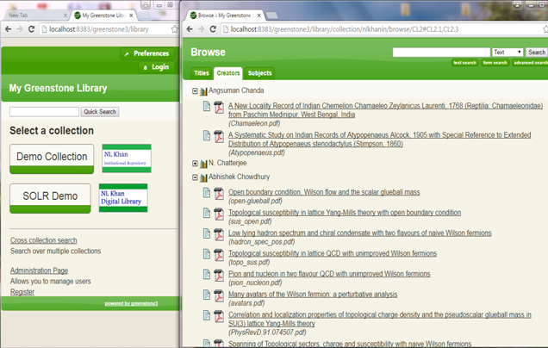
Institutional Digital Repository (GSDL)

Slide 23
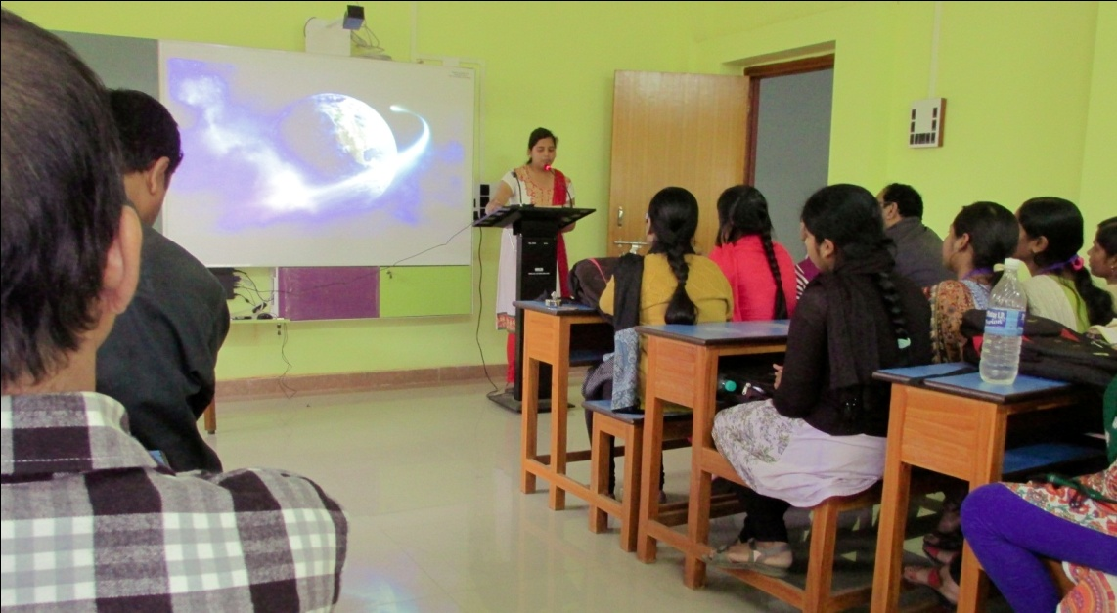
Book Talk

Slide 24
Progress of the Library in Last Five Years
Introduction of Open Access System for the students
Acquisition of more than 8000 books.
Addition of 10 Journals, and 1 National News Paper.
Installation of a new server PC.
Installation of Soul 2.0 & Open Source ILMS Koha
Installation of Digital Library Software DSpace
Hosting the new Web OPAC and MOPAC
Initiation of user portal to submit their Suggestions for Books and Journals
Utilization of various Fund like CPE, DST, BSR, RUSA, PC Chandra Gyandhara etc.

Slide 25
Progress of the Library …
Expansion of the area of the Library.
Introduction of Wi-Fi facility in the Reading Room.
Introduction of new extension services like Book Talk and Book Exhibition.
More space for the users. Presently, almost 70% of the floor area of the Library is open for the student.

Slide 26
Time Series Data of Acquisition of Books
Year | No. of Books
1957 | 622
1960 | 2930
1965 | 5220
1970 | 8452
1975 | 11257
1980 | 13330
1985 | 15890
1990 | 20752
1995 | 22382
2000 | 26373
2005 | 28234
2010 | 30146
2015 | 35655
2016- | 38125

Slide 27
Year wise progress in Collection of Central Library

Slide 28
Usage Statistics of the Library
Transaction per day: 150
Average attendance in the Library per day: 235 (Students - 223, Teachers - 10, Non-teaching staff - 2)
Average No. of Books consulted in Reading Room per day: 75
Total Pages visited and downloaded on the Online Database NLIST during 2017-2018 is 20,000

Slide 29
Future Plan
Digitization of old and rare books
Separate sections for PG students and Research Scholars
Separate E-Learning Laboratory
Application of RFID in Library System
Set up a environment friendly Green Library

Slide 30
Library Committee
President: | Dr. Jayashree Laha, Principal, ex officio
Convener: | Biswajit Adhikary, Librarian
Members: | All the internal members of Governing Body
 | All the HODs or their representatives
 | Students’ representative to the GB
 | Mintu Kumar Bose, Library Staff
 | Susanta Kumar Roy, Library Staff

Slide 31
Our Team
Biswajit Adhikary, M.Sc., MLISc. Ph.D. (Librarian)
Mintu Kumar Bose, B.A., BLISc. (Library Clerk)
Susanta Kumar Roy, B.Sc. (Library Attendant)
Mita Das, H.S. (Casual Staff)
Upasana Gurung, B.A. (Casual Staff)

Slide 32
Thank You

